Slide 1
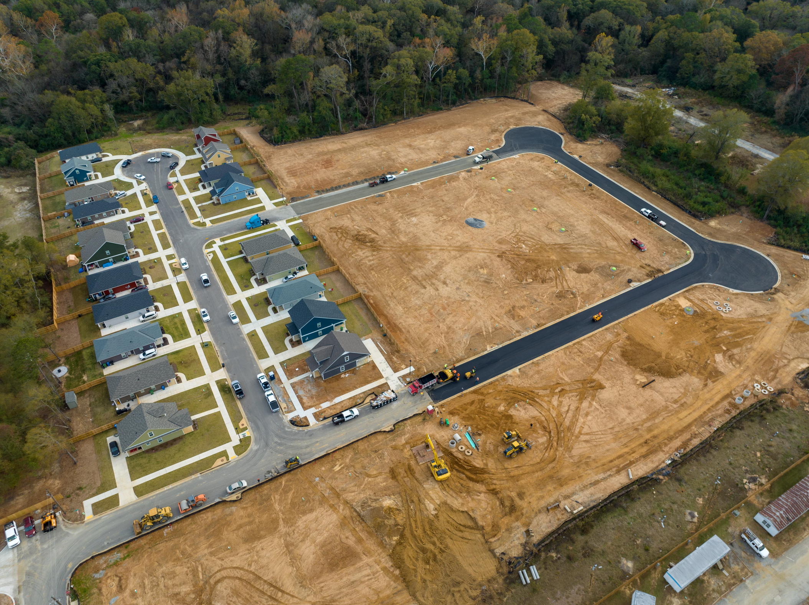


NeighborWorks Columbus FHLB DPA Program
2026
Created by
Shadonna Woodcock and Nonie Milner

Slide 2



About NeighborWorks® Columbus:
NeighborWorks® Columbus is a community-based 501c(3) nonprofit enterprise offering programs and services that empower customers to achieve their dreams of homeownership. NeighborWorks® Columbus has a mission to provide access to fit and affordable housing and build assets for Financial independence for all citizens of low to moderate income. NeighborWorks ® Columbus ‘ vision and deep commitment remain to improve the quality of life and maintain public trust.
The Homeownership Center: Our Homeownership Center is dedicated to making customers dream of homeownership a reality.
The Lending Department: The Lending Department is here to serve customers. Whether they’re looking for a mortgage loan or down payment assistance.
Real Estate Development: Our Real Estate Development Department is responsible for the development of affordable housing.

Slide 3
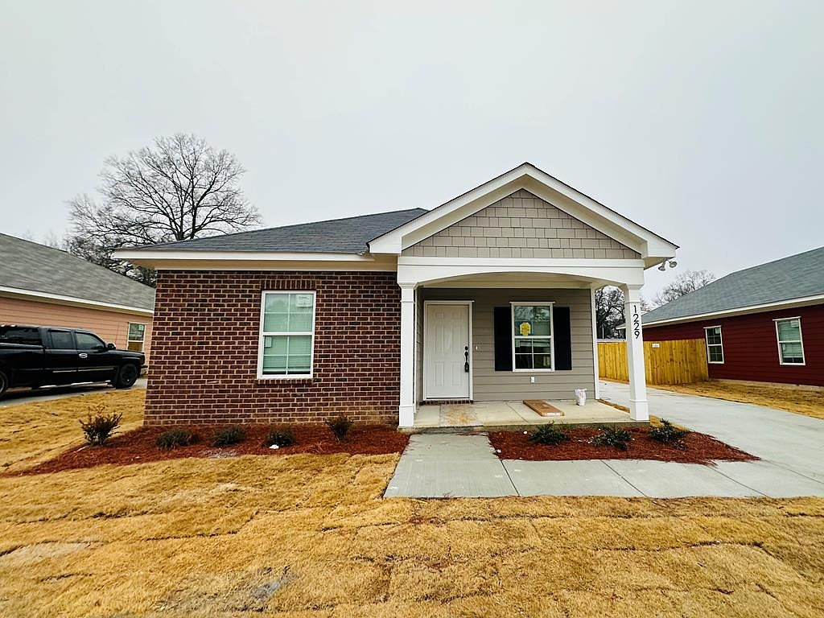

NeighborWorks Columbus FHLBank Atlanta Down Payment Assistance Program
  Roles & Responsibilities Program Overview
  Required Documents upon applying
  Timeline
  Pre-Funding
  Post- Closing

Slide 4
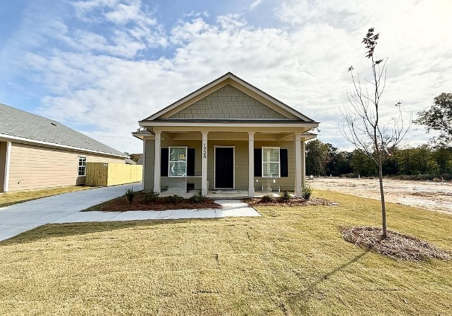
ROLES & RESPONSIBILITIES
NeighborWorks Columbus Responsibilities:
Lender Responsibilities:
  NeighborWorks Columbus receives and reviews all applications
  NeighborWorks Columbus submits applications to FHLB
  NeighborWorks Columbus issues the conditional commitment letter if approved
  NeighborWorks Columbus sends funds to the attorney’s office
  Only NeighborWorks Columbus will communicate with FHLB
  The lender is responsible for applying 45 calendar days before closing.
  Reading the guidelines
  Making sure all documents are accurate
  Communicating with the staff at NeighborWorks Columbus about any changes that occur during this process
  Making sure the final CD, Note, and Deed are correct prior to the borrower’s signature.

Slide 5

Required documents when applying
  FHLB 2026 Intake Certification Form- include all pages-If signed electronically, you must include a signature summary
  Financing and Mortgage Worksheet -Note: you must calculate your numbers correctly
  AHP-Zero Income Certification (if applicable)
  Self-Employed Income—1 year tax return is needed; NWC will analyze the most recent filed Federal tax return with all schedules to determine the appropriate gross income for the household
  Thirty(30) days of current and consecutive income that include pay periods for the current year must be documented.
  The Verification of Employment (VOE) is the preferred method to confirm the income. NOTE: The Verification of employment must include overtime, additional pay, bonuses, frequency of bonuses, if employment is seasonal, Etc.
  Signed Offer Letters that list a start date and salary amount are acceptable
  SSI Income / VA Benefit Letter within 12 months
  Child Support court order with 2 months of payments
  Most recent 2 months of bank statements (All pages and no redactions)
  Community partner work ID/ Badge/Copy of the employer webpage)
  1003 Dependents need to match the intake form
  Appraisals are needed if the property is a new construction. The flood cert will be acceptable if the census tract is indicated of the certification

Slide 6
TIMELINE:
The lender applies for FHLB/DPA on the borrowers’ behalf. https://app.smartsheet.com/b/form/2a4d233b84654829915b8bcc45f31d0f
NeighborWorks Columbus will review all applications within 72 hours due to the heavy workload.
NeighborWorks Columbus will submit your application to FHLB.
NeighborWorks Columbus will email you about your application submission to FHLB.
FHLB reviews all applications within 7 business days – subject to change depending on FHLB volume
Once FHLB has completed its review, you will receive a notification on the next step.
Tips to keep in mind:
Start your application process as soon as you receive a signed contract
Closings cannot be NO SOONER than 45 calendar days from the date you are notified about your submission
NeighborWorks Columbus cannot rush FHLB during this process
Lenders are not to call, email, or communicate with any staff at FHLB on NWC’s behalf.
Lenders must communicate any delays to your borrowers and/or realtors
NeighborWorks Columbus will not communicate with your borrowers or realtors

Slide 7




PRE- FUNDING:
The lender will receive a conditional commitment letter from NeighborWorks Columbus once FHLB has completed the application review. The conditional commitment letter is good for 45 calendar days. *Please send this document to your attorney as well*.
All requested documents must be sent to NeighborWorks Columbus as soon as possible. Please DO NOT PIECE MAIL THESE DOCUMENTS
VERY Important: NWC needs to review your final CD before we can allow the attorney to fund.
Do not go to the closing table if you have not received clearance from NWC Staff
Homebuyers have 7 calendar days to close after funds have been approved by FHLB. After the 7th day, if a borrower has not closed, funds must be returned to FHLB. *Application is deemed null and void*

Slide 8
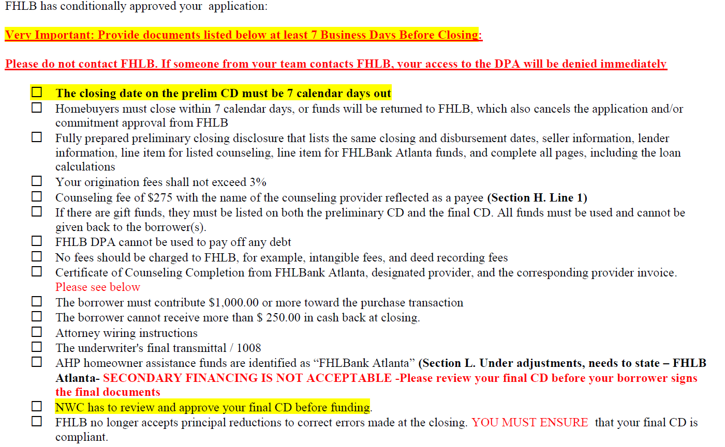


CONDITIONAL COMMITMENT LETTER:
The Conditional Commitment Letter is critical. This confirms your FHLB application approval. The lender must read each line item to avoid any errors.

Slide 9
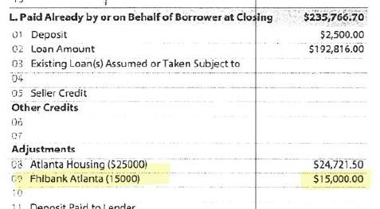

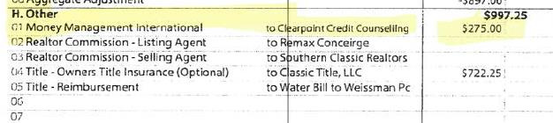
REQUIRED NOTATIONS ON CLOSING DISCLOSURE:

Slide 10



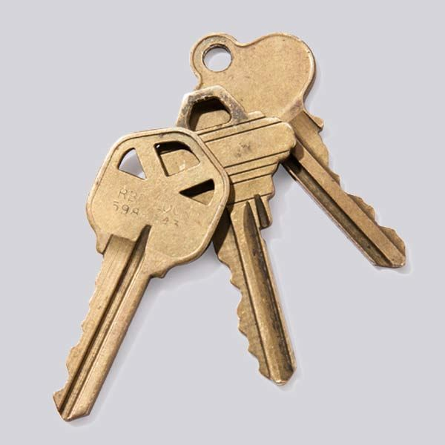
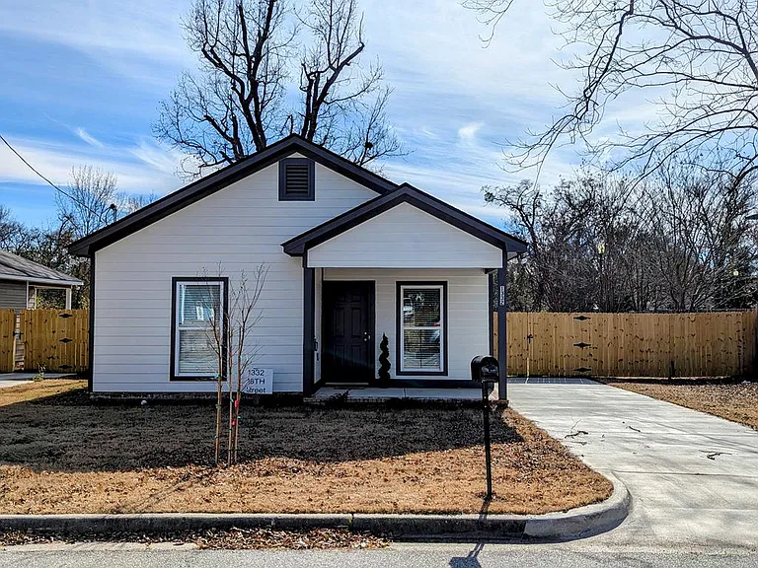
POST-CLOSING
After closing, it is the lender and attorney’s office’s responsibility to send NeighborWorks Columbus the following documents:
Buyers CD
Seller CD
FHLB Deed ( if applicable)
FHLB Note ( if applicable)
Proof of the counseling payment
If you fail to do so, NeighborWorks Columbus will not review or submit any applications until all post documents have been received

Slide 11
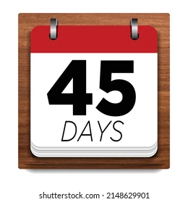

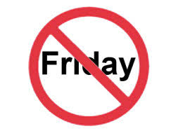

TIMING NOTES:
  Closing date: No sooner than 45 calendar days.
  The days count above do not include holidays
  Applications will be reviewed as they are correctly and completely submitted before sending to FHLBank Atlanta
  Failure to submit a complete file WILL DELAY your application beyond the dates above.
  NeighborWorks Columbus will shut down our Smartsheet at 2:00 p.m. Monday –Thursday and will open back up on Monday.
  No applications will be processed on Fridays.

Slide 12

TWO-STRIKE RULE WILL BE ENFORCED IN 2026
  Regarding application discrepancies: After the 2nd material discrepancy, lenders will be required to complete additional training to continue submitting applications.
  Any discrepancies after additional training has occurred will result in the lender becoming ineligible to submit additional applications for the remainder of the funding period.

Slide 13
COMMON ISSUES
Incomplete Packages
The number of dependents and/or non-occupant co-borrower information does not match the 1003 and intake certification
All sources of income are not included
Overtime is not calculated correctly
Child support is not included on the 1003
Proof of child support is not included
You must disclose any monetary gifts received by the borrower
VOE -More than 30 days old
New Construction – Requires an appraisal
The origination fee is higher on the Final CD than on the approved Preliminary CD/ The origination fee shall not exceed 3%
The Closing date must be at least 7 days from receipt of the Preliminary CD
Closing and Disbursement Dates must match
Property, Borrower, Seller and Loan information must be complete
You cannot charge a fee for the FHLB DPA
The CD must have the correct title for HBE Counseling and FHLB Atlanta
The borrower cannot receive more than $250 cash back
The borrower must contribute at least $1000
If there are gift funds, they must be on both the preliminary CD and the final CD
All gift funds must be used –it cannot be given as cashback.
You must complete all sections
Cash to close
Additional information about this loan
Contact information
Loan Calculations
Contact Information

Slide 14
COMMON ISSUES CONTINUED
All sources of DPA are not included
Intake Certification- If there is a non-occupant co-borrower monthly contribution cannot be blank. If zero is the contribution put zero
All final conditions should be submitted in one complete package
The closing attorney checklist must be followed
Please check that wiring instructions are accurate before sharing
We must be notified when a closing date changes
We must be notified when the loan amount for the 1st mortgage changes
The Loan must be cleared to close before final conditions are sent to us.
Do not go to the closing table if you have not received clearance from NWC Staff
Post Closing
Post Closing emailed, and FedEx documents must be submitted in a timely fashion
Retention documents must be executed on the closing date – all dates must be the same.

Slide 15
FREQUENTLY ASKED QUESTIONS
What is the best way to contact NeighborWorks Columbus staff?
Emailing us will get you the fastest response.
Are funds still available? Always check by going to our website: https://nwcolumbus.org/down-payment-assistance/
Can FHLB take 3rd position behind other DPAs? Yes
Are there maximum Debt-to-Income requirements? No
Does FHLB require additional fees? NO
Can a lender/processor call FHLB? NO
Can the origination fee exceed 3%? NO

Slide 16
If a borrower is buying with a non-occupying borrower,
can they still qualify for the DPA?
Yes, but that individual must disclose any funds they will be contributing to the monthly home payments on the Non-Occupant Certification in the Homebuyer Intake Certification Form. If they are contributing to the down payment or any other income to the borrower, that needs to be disclosed as well.
Is there a maximum sales price?
No. However, the household income limit will naturally limit the cost of the home that the buyer can afford. We encourage following the 30% Rule, in that housing costs should be no more than 30% of household income.

Slide 17
Is there a minimum credit score?
Credit scores and ratios are set by the participating lenders.
All borrowers must complete the required course, Money Management or Credit.org, per the conditional commitment letter.
Yes, after they receive a commitment letter.
.

Slide 18

REMINDER:
Please send all inquiries to nmilner@nwcolumbus.org
PLEASE REVIEW THE PROGRAM GUIDELINES FOR A COMPLETE LIST OF REQUIREMENTS, including but not limited to:
Thirty(30) days of current and consecutive paystubs or a complete VOE
Verification of Employment Form is the preferred form for income verification from FHLB
Current Bank Statements
Zero Income Certification (as applicable) – anyone 18 years + with no income
SSI, Disability, child support, and other income documentation as applicable
PLEASE NOTE:
Annual income is based on gross earnings. Income documentation must include any bonuses and overtime, even if just a one-time
Income documentation must be dated within 30 days of intake

Slide 19
RESOURCES:
NeighborWorks Columbus FHLB DPA
https://nwcolumbus.org/down-payment-assistance/
FHLBank Atlanta- Income Limits Calculator https://cis.fhlbatl.com/regsponsor/#/incomecalculation
NeighborWorks Columbus FHLB Application https://app.smartsheet.com/b/form/2a4d233b84654829915b8bcc45f31d0f.

Slide 20
NWC STAFF CONTACT INFO:
Lisa Joseph- ljoseph@nwcolumbus.org 706-221-8361 - Director of Lending / FHLB Program Manager
Shadonna Woodcock – shadonna@nwcolumbus.org 706-221-8575- Mortgage Loan Processor / FHLB Approver
Nonie Milner - nmilner@nwcolumbus.org 706-221-8279- Mortgage Loan Originator / FHLB Submitter
Office hours: Monday-Thursday 8:30 am- 4:30 pm
No applications will be reviewed or processed on Fridays

Slide 21
